Slide 1
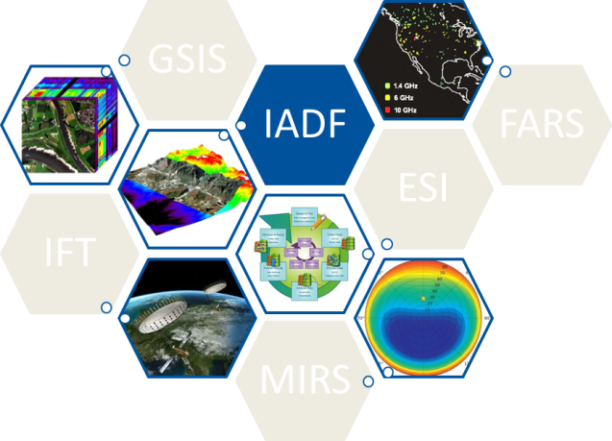

Image Analysis and Data Fusion
Bertrand Le Saux
IADF chair
Ronny Hänsch
Naoto Yokoya
IADF co-chairs

Slide 2
Image Analysis and Data Fusion
491 members in IADF TC (+97 since 01/2017)
(incl. industry presence: ESA, DLR, Digital Globe, Apple, Deimos Imaging, JRC, Optech, EADS Innovation, Telops Inc., A.U.G. Signals, Astrium, NASA Goddard, Mitsubishi Research, AGT international, GLOBI Hi-Tech, PCI Geomatics, MHA Technologies, Specktech, Bio-Geo-Recon, Long-Short Way Inc.,…),
2159 members in Linkedin Discussion group
Today’s talk:
IGARSS sessions and tutorials
Publications
Data Fusion Contest 2018
Earth Vision 2019

Slide 3
Image Analysis and Data Fusion
IGARSS sessions:
Data Fusion invited session
10 technical papers on “multi+” data processing
(Longbotham, Pohl, Chanussot, Chehata, Liao, Sakaruda…)
All sensors, both methodological and application-oriented topics (pansharpening, unmixing, deep learning, forest monitoring, urban detection)
Data Fusion Contest invited session
1 overview talk about the contest / 4 technical papers by the winners

Slide 4
Image Analysis and Data Fusion
IGARSS tutorial on Machine Learning in Remote Sensing
Spread good practices for data preparation
Present efficient and advanced machine learning tools
Speakers:
Ronny Hänsch, Bertrand Le Saux, Yuliya Tarabalka, Devis Tuia

Slide 5
Image Analysis and Data Fusion
Publications:
JSTARS paper on the outcome of the 2017 Contest: accepted after minor revision, in press.
Column paper in GRSM announcing the 2018 Contest: in press
(March issue)

Slide 6

Image Analysis and Data Fusion
Ongoing activities: Data Fusion Contest 2018
Advanced multi-sensor optical remote sensing for urban land use and land cover classification
Guest organizer: Saurabh Prasad (Houston Univ.)

Slide 7
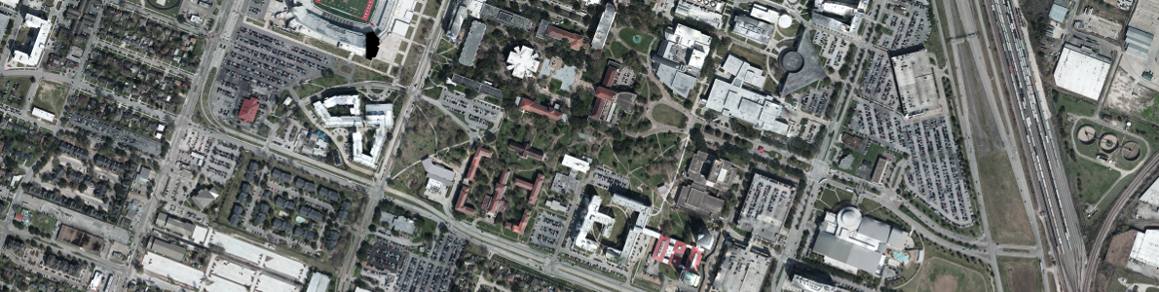
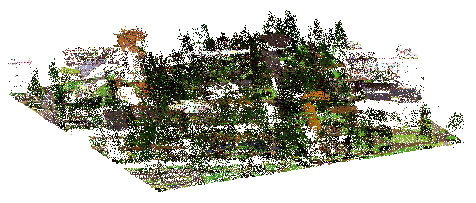
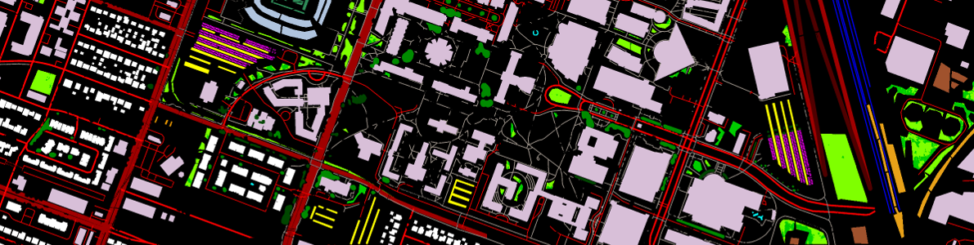
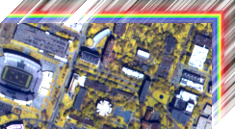
Image Analysis and Data Fusion
Ongoing activities: Data Fusion Contest 2018
Multi-sensor data with exciting new sensors:
Hyperspectral imagery (VNIR, 1-m GSD)
VHR RGB imagery (5-cm GSD)
Multispectral-LiDAR point clouds, intensity rasters and DSMs (0.5-m GSD)
VHR imagery
MS LiDAR point cloud
20-class ground-truth
HS data cube

Slide 8
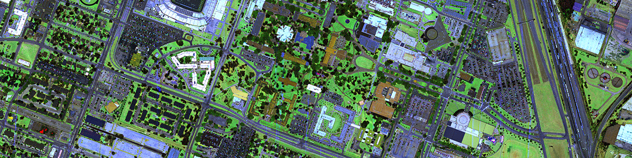
Image Analysis and Data Fusion
Ongoing activities: Data Fusion Contest 2018
Benchmark for urban land use and land cover classification (20 detailed urban classes with materials and vegetal subclasses):
Unclassified, Healthy grass, Stressed grass, Artificial turf, Evergreen / Deciduous trees, Bare earth, Water, Residential buildings, Commercial buildings, Roads, Sidewalks, Crosswalks, Major thoroughfares, Highways, Railways, Paved / Unpaved
parking lots, Cars, Trains, Stadium seats
Data fusion and per-sensor tracks

Slide 9
Image Analysis and Data Fusion
Ongoing activities: Data Fusion Contest 2018
Calendar:
Training set (1.4km² in central Houston) was released on Jan. 15th
→ 253 downloads so far, better than 2017
Test set (3.5km²) will be disclosed on March 13th
Submission deadline on DASE is March 25th
Prizes:
1st to 4th teams: IEEE Certificates of Recognition +
IGARSS invited session
1st and 2nd teams: co-author JSTARS submission
1st team: NVIDIA GPU graphic card

Slide 10
Image Analysis and Data Fusion
Ongoing activities: Data Fusion Contest 2018
Our goals:
Explore assets/complementaries of various sensors for the same applications
Bring together people from the technical IADF community and people working on advanced sensor development
Make innovative and interdisciplinary applications emerge
In parallel, GRSL special stream for open research and novel applications with these new sensors

Slide 11
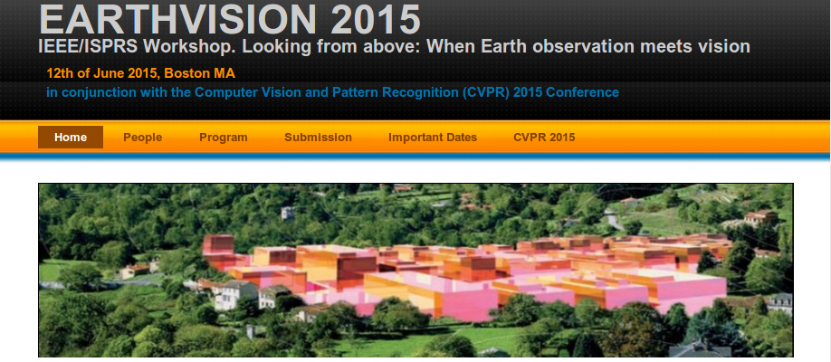
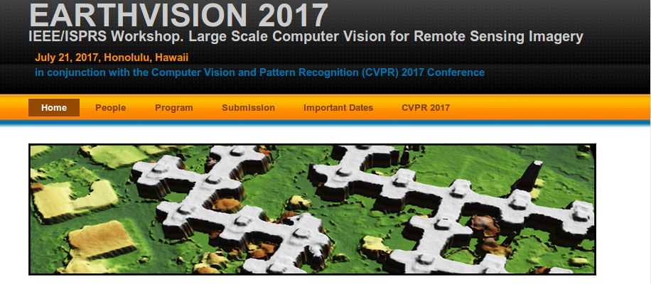
Image Analysis and Data Fusion
50% activities proposal: EARTHVISION’19 workshop
Build up on the successes of EV’15 and EV’17
Workshop proposal at CVPR’19 (Long Beach, Cal., USA, June 16-21, 2019) (deadline: october 2018)
Gather people and stellar keynote speakers from GRS and CV/ML, from both industry and academia
High-quality papers: double-blind review process, high selection rate (around 25%)

Slide 12
Image Analysis and Data Fusion
50% activities proposal: EARTHVISION’19 workshop
GRSS funding ($15K) will be used to cover
Keynote speakers’ expenditures
Organizers’ travel expenditures (partially)
Best paper prize
Expected return of investment
Expanded GRSS membership (Globalization)
Expanded participation to IGARSS and other GRSS conferences/workshops (Education)
Increased awareness of GRSS initiatives, including DASE, in IEEE CompSoc (Globalization / Education)
Possible evaluation metrics
Number workshop participants (by itself and as compared to 2015/2017)
% workshop participants, who are not yet GRSS members

